Slide 1
Team 5 – Rotor Blade Structures
Week number: 2
Date: 07.10.2025
Supervisor: Dr. Laurence Alhrshy
Bhima B Masare, Anudeep Allanki, Dongsuk Kim, Mithun Shetty

Slide 2
Weekly Report – Team Rotor Blade Structures
Week 02
Presented By
Anudeep Allanki

Slide 3
Contents
Sample Blade Geometry by Aero Team
Positioning the Airfoils (will be provided by Aero Team)
Calculating Blade Structural properties
Bibliography
Anudeep Allanki

Slide 4
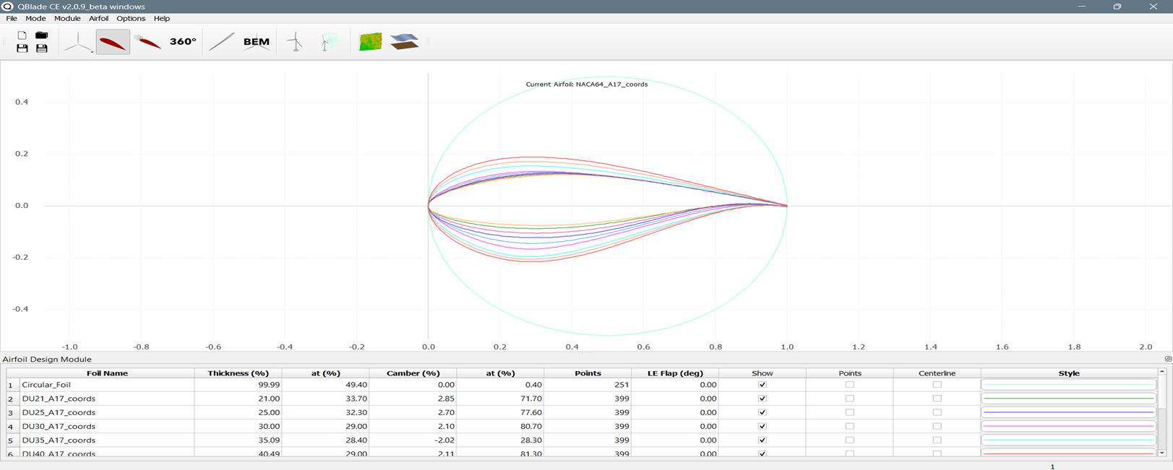
Sample Blade Geometry by Aero Team
Circular Foil
DU21
DU25
DU30
DU35
DU40
NACA64
Anudeep Allanki

Slide 5
Sample Blade Geometry by Aero Team
Rearrange the Airfoils positions on Blade span (correction)
From Root to tip of Blade the order follows –
Circular Foil1
Circular Foil 2
DU40
DU35
DU30
DU25
DU21
NACA64
Note –
NACA 0060 can be added followed by circular foils as per observations from WEC Optimus Shakti 2024
Anudeep Allanki

Slide 6
Data needed to proceed further
 | Data required from Aero Team
 | Data calculated by Structure Team
Anudeep Allanki

Slide 7
Bibliography
Definition of a 5 MW/61.5m Wind Turbine Blade Reference Model by Brian R. Resor, Sandia National Laboratories, California, USA
Definition of a 5 MW Reference Wind Turbine for Offshore System Development, J. Jonkman, S. Butterfield, W. Musial, and G. Scott, National Renewable Energy Laboratory, USA
Q Blade Design from Blade Aerodynamics Team

